Slide 1

Youngstown State University
MCIS – Data Engineering Capstone Project
AI Enhanced Configuration Optimization and Security for Network Management and Analysis
Presenter and Author: Daniel P Yoder
Faculty Coach: Mr. Todd Jones
Capstone Coordinator: Dr. Feng (George) Yu

Slide 2

Introduction
Increasing complexity of network infrastructure and modern cybersecurity threats.
Need for AI to supplement manual configuration baselining and log analysis.
Role of Large Language Models (LLMs) in automating and enhancing incident response.

Slide 3
Background
Emergence of LLMs like OpenAI’s ChatGPT, Google Gemini, Microsoft Copilot, and X’s Grok.
LLMs use transformer models to maintain context and generate complex responses.
Applications in various industries including healthcare, education, business, and cybersecurity.

Slide 4
Problem Statement
Cybersecurity threats are overwhelming security teams.
Exploration of AI and LLMs for baseline configurations and log analysis.

Slide 5

Methodologies
Testing effectiveness of LLMs using Cisco networking equipment configurations.
Testing pattern recognition in logs related to security incidents.
Models used: Google Gemini 2.0 Flash, Microsoft Copilot, ChatGPT 4.0, Grok 3.
Evaluation based on ability to recognize misconfigurations/sign-in logs and suggest improvements.

Slide 6

Experimentation
Clean dataset vs. mixed dataset for configuration tests.
Clean is a baseline and overall secure or normal configuration or sign-in log.
Mixed is insecure or suspicious.
Prompts used for configuration and log/alert tests:
The prompt for each configuration test is “Please review the attached switch configuration for any security errors: “
The prompt for each log/alert test is “Please review the attached sign-in logs for any threat patterns: “
Results categorized as ‘satisfactory’ or ‘unsatisfactory’.

Slide 7
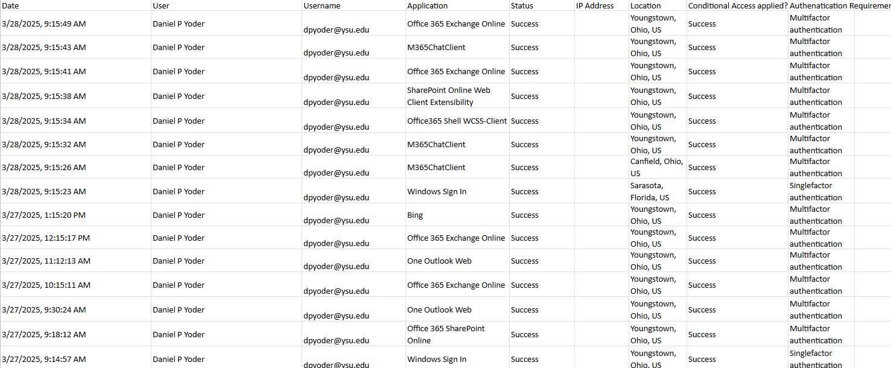
Example Dataset

Slide 8
Example Result - Grok 3
Analyzing the provided sign-in logs for the user Daniel P. Yoder (dpyoder@ysu.edu), several potential threat patterns and anomalies emerge that warrant further investigation. Below is a detailed review of the logs, focusing on patterns that could indicate security risks, followed by recommendations for mitigation.
Geographical Anomalies and Rapid Location Changes:
Details:
On 3/28/2025, within a 26-second window (9:15:23 AM to 9:15:49 AM), the user successfully signed in from three different locations: Sarasota, Florida (9:15:23 AM, Windows Sign In), Canfield, Ohio (9:15:26 AM, M365ChatClient), and Youngstown, Ohio (multiple sign-ins starting 9:15:32 AM).
On 3/27/2025, sign-ins occurred from Los Angeles, California (9:12:56 AM, failed), New York, New York (8:14:25 AM, success), and Youngstown, Ohio (multiple times throughout the day).
Risk:
Rapid changes in location within short timeframes (e.g., Florida to Ohio in seconds) are physically implausible, suggesting possible account compromise, session hijacking, or VPN/proxy usage to mask the true location.
The failed attempt from Los Angeles and successful sign-in from New York on 3/27/2025 could indicate brute-force attempts or unauthorized access from unfamiliar locations.
Analysis:
The Sarasota to Ohio jump on 3/28/2025 is particularly suspicious, as it occurs across multiple applications in under 30 seconds.
New York and Los Angeles are outliers compared to the user’s typical locations (Youngstown, Warren, Hubbard, Canfield—all in Ohio).
The lack of IP addresses in the logs makes it harder to confirm if these are distinct devices or sessions, but the location data alone raises red flags.

Slide 9
Results - Configuration Recognition (Clean)
 | Test 1 | Test 2 | Test 3 | Test 4 | Test 5 | Test 6 | Test 7 | Test 8 | Test 9 | Test 10
ChatGPT | Pass | Pass | Pass | Pass | Pass | Pass | Pass | Pass | Pass | Pass
Gemini | Pass | Pass | Pass | Pass | Pass | Pass | Pass | Pass | Pass | Pass
Grok 3 | Pass | Pass | Pass | Pass | Pass | Pass | Pass | Pass | Pass | Pass
Copilot | Pass | Pass | Pass | Pass | Pass | Pass | Pass | Pass | Pass | Pass

Slide 10
Results - Log Threat Recognition (Clean)
 | Test 1 | Test 2 | Test 3 | Test 4 | Test 5 | Test 6 | Test 7 | Test 8 | Test 9 | Test 10
ChatGPT | Fail | Fail | Fail | Pass | Pass | Pass | Pass | Pass | Pass | Pass
Gemini | Fail | Fail | Fail | Fail | Fail | Fail | Fail | Fail | Fail | Fail
Grok 3 | Pass | Pass | Pass | Pass | Pass | Pass | Pass | Pass | Pass | Pass
Copilot | Pass | Pass | Pass | Pass | Pass | Pass | Pass | Pass | Pass | Pass

Slide 11
Results - Configuration Recognition (Mixed)
 | Test 1 | Test 2 | Test 3 | Test 4 | Test 5 | Test 6 | Test 7 | Test 8 | Test 9 | Test 10
ChatGPT | Pass | Pass | Pass | Pass | Pass | Pass | Pass | Pass | Pass | Pass
Gemini | Fail | Fail | Pass | Fail | Pass | Pass | Pass | Fail | Pass | Pass
Grok 3 | Pass | Pass | Pass | Pass | Pass | Pass | Pass | Pass | Pass | Pass
Copilot | Pass | Fail | Pass | Pass | Pass | Pass | Pass | Pass | Pass | Pass

Slide 12
Results - Alert Recognition (Mixed)
 | Test 1 | Test 2 | Test 3 | Test 4 | Test 5 | Test 6 | Test 7 | Test 8 | Test 9 | Test 10
ChatGPT | Fail | Fail | Fail | Fail | Fail | Fail | Fail | Fail | Fail | Fail
Gemini | Fail | Pass | Pass | Pass | Pass | Fail | Pass | Pass | Fail | Pass
Grok 3 | Pass | Pass | Pass | Pass | Pass | Pass | Pass | Pass | Pass | Pass
Copilot | Pass | Pass | Pass | Pass | Pass | Pass | Pass | Pass | Pass | Pass

Slide 13
Findings
LLMs show varying levels of accuracy in configuration and log analysis.
ChatGPT and Grok 3 performed consistently well.
Gemini struggled with log threat recognition.
Copilot showed strong performance overall.

Slide 14

Conclusion
AI and LLMs can significantly aid in network configuration optimization and security.
Continuous advancements are needed to improve accuracy and reliability.
Future research should focus on refining LLMs for cybersecurity applications.

Slide 15
Sources
Amanatullah. (2023, September 1). Transformer architecture explained. Medium. https://medium.com/@amanatulla1606/transformer-architecture-explained-2c49e2257b4c
Motlagh, F. N., Hajizadeh, M., Majd, M., Najafi, P., Cheng, F., & Meinel, C. (2024, January 30). Large language models in cybersecurity: State-of-the-art. ArXiv.org. https://arxiv.org/abs/2402.00891
Thakare, I. & Fagare, R. & Khuspe, S.. (2023). Impact of Chatgpt on Industry. Journal of Advanced Zoology. 44. 10.53555/jaz.v44iS8.3548
What is an LLM (large language model)? | cloudflare. (n.d.-a). https://www.cloudflare.com/learning/ai/what-is-large-language-model/
What is LLM? - large language models explained - AWS. (n.d.-b). https://aws.amazon.com/what-is/large-language-model/
Xai docs. Overview. (n.d.). https://docs.x.ai/docs/overview#welcome

